Slide 1
Hotel Recommendation using Sentiment Analysis
Group Members:
Sai Naveen Chanumolu (017046991)
Shashank Muthuraj (016888027)
Vamsi Agnihothram (016920709)

Slide 2
Introduction:
Sentiment analysis: We used NLP techniques to extract subjective information, like opinions and emotions, from text data. We utilized this tech to ultimately give out ratings from reviews. We used Bidirectional Representation for Transformers to bring out 3 classes of sentiments from the reviews. Sometimes opinions in reviews give better ratings than numbers.
Sources for reviews in the dataset: online reviews from travel websites, social media, customer feedback forms, etc.
Dataset:
Source: The dataset is obtained from Part of Datafiniti Business Database that focuses on hotel reviews from Kaggle, an extensive collection of data for analytics and ML.
Volume: 2 datasets of 10,000 records each that belongs to 2 different time frames & dif hotels. Used Py code to Merge to approx 20,000 hotel reviews, a rich and diverse pool of data. Removed unnecessary columns & null rows.
Composition: Essential details for our ML model like hotel name, address, city, geographical coordinates(L & L), and customer reviews comprising ratings, review texts, titles, and other info. Allows comprehensive analysis.

Slide 3
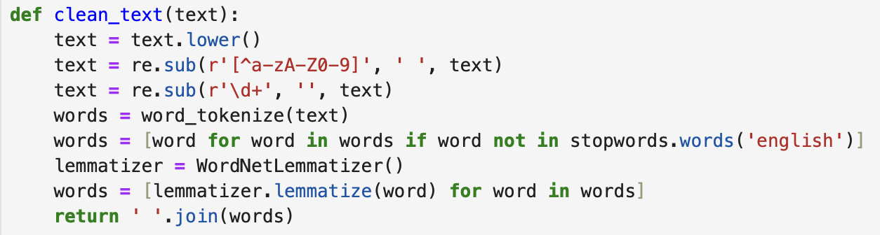
Data Preprocessing - mining methods
Combine sub columns of reviews and then for each review entry:
Lowercase Conversion
Removing Non-Alphanumeric Characters
Tokenization
Removing Stopwords
Lemmatization: Running -> Run
df['review'] = df['review'].apply(clean_text)

Slide 4
Sentiment Analysis with BERT
BERT Model for Sentiment Analysis
Model Used: bert-base-multilingual-uncased-sentiment, a pre-trained BERT model(From hugging face) capable of understanding multiple languages in an uncased format.
Purpose: Leverage BERT's advanced NLP capabilities to interpret and analyze the sentiment expressed in hotel reviews.
Sentiment Extraction
Method: Applied the BERT model to the review column of the dataset to extract sentiment ratings.
Sentiment Ratings: The model outputs sentiment ratings as labels (e.g., "1 star" to "5 stars"), reflecting the sentiment intensity in each review.
Rationale for Using BERT
Contextual Understanding: BERT's bidirectional training allows it to understand the context of each word in a sentence, a significant advantage for accurately gauging sentiments.
Handling Complex Patterns: Capable of capturing complex language patterns, idiomatic expressions, and subtle nuances in reviews, which are crucial for accurate sentiment analysis.

Slide 5
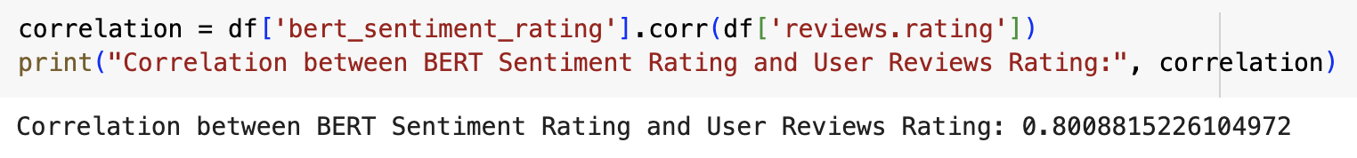
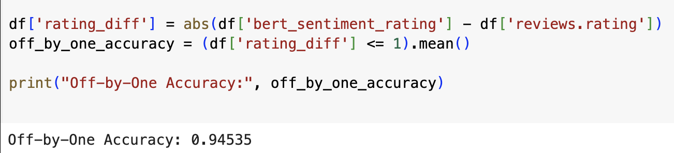
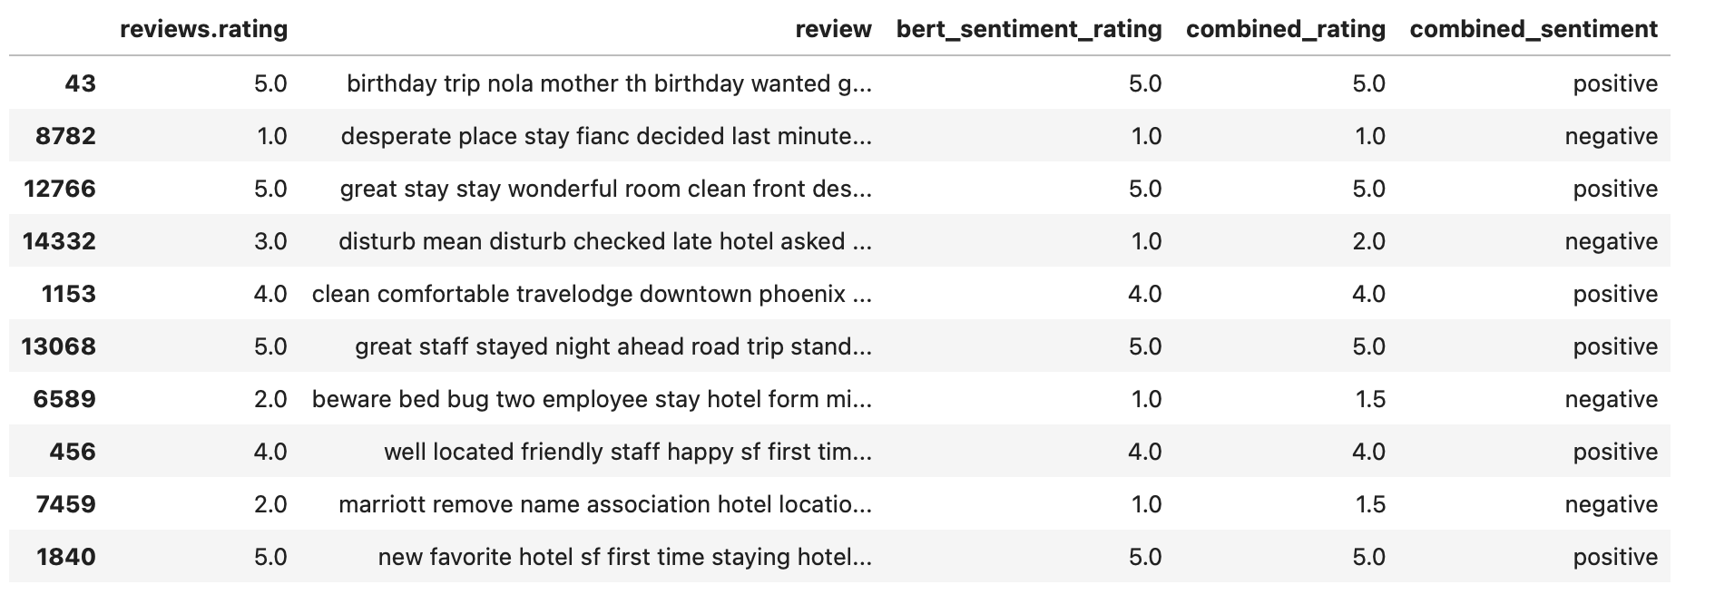
Sentiment Analysis with BERT

Slide 6
Model Training and Evaluation
Models Used
Random Forest Classifier: A versatile machine learning model that works well for classification tasks. It builds multiple decision trees and merges them together to get a more accurate and stable prediction.
Support Vector Machine (SVM): An effective classification model, especially known for its accuracy in high-dimensional spaces, like text data. It finds a hyperplane in an N-dimensional space that distinctly classifies the data points
XGBoost: A highly efficient and scalable implementation of gradient boosting. It also builds a ensemble decision trees sequentially and tries to correct the errors made by the previous trees

Slide 7
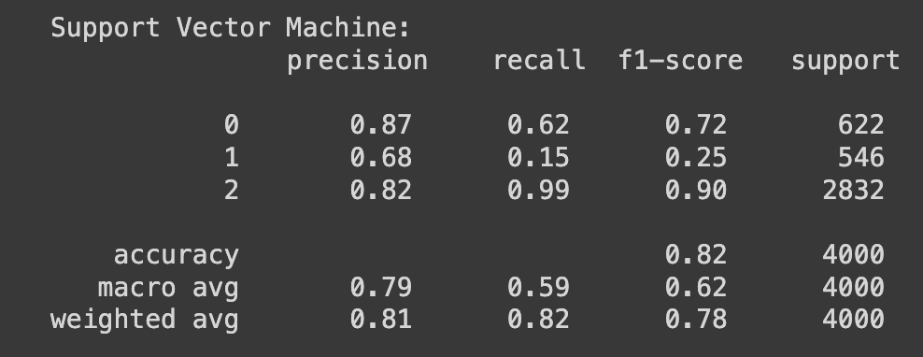
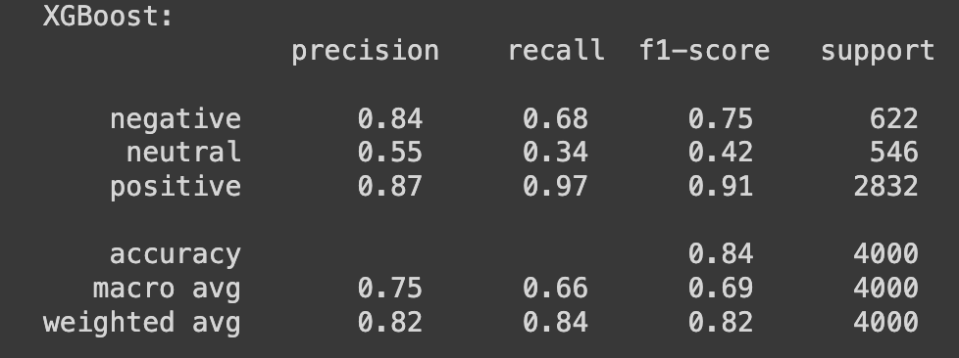
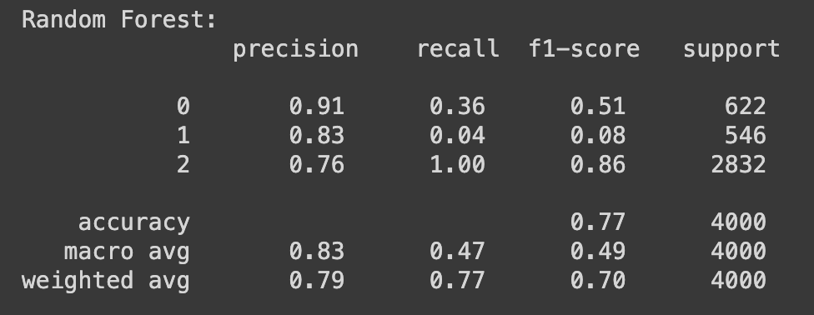
Model Training and Evaluation(Cont)
Each model was trained on the TF-IDF transformed text data(reviews) and the corresponding sentiment labels.

Slide 8
Application Demo

Slide 9
References:
1.Hotel Reviews Dataset (kaggle):https://www.kaggle.com/datasets/datafiniti/hotel-reviews?select=Datafiniti_Hotel_Reviews.csv
2.Pandas: https://pandas.pydata.org/
3.NLTK: https://www.nltk.org/
4.SKlearn:https://scikit-learn.org/stable/
5.https://ieeexplore.ieee.org/abstract/document/9650096?casa_token=_QfXlN9hZ7cAAAAA:lfzQUIrAaHq9FYaUDssJ8Mkx7GSPfH6MarZQUDZzCplg5hRQNl4GaPmZG-raIbRPsdv7hNY
6.https://scikit-learn.org/stable/modules/svm.html
7.https://scikit-learn.org/stable/modules/generated/sklearn.ensemble.RandomForestClassifier.html

Slide 10
Questions?
Thank You!!

